Slide 1
Human Motion Style Transfer
Nguyen THANH (1)
20 Aug 2016
High Dimensional Heterogeneous Data based Animation Techniques for Southeast Asian Intangible Cultural Heritage Digital Content - AniAge

Slide 2
Outline
1. AniAge overview
2. Human Pose Estimation, Key Frame Extraction
3. Human Motion Style Transfer
4. GAP of motion Registration and Annotation

Slide 3
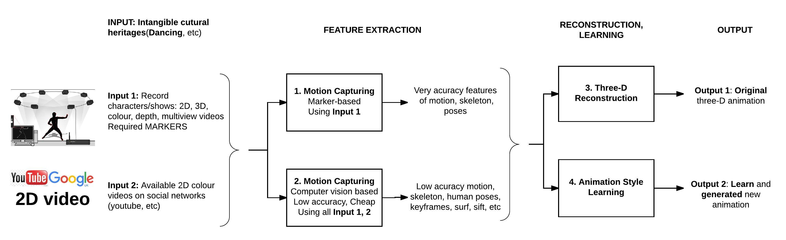
1. Overview
My Topics
Figure 1: Overview

Slide 4
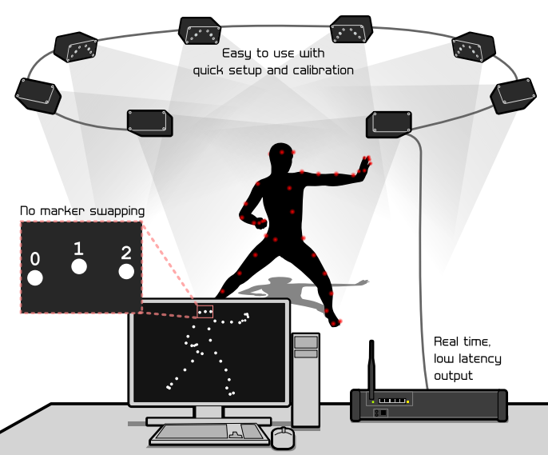
1. Overview: Human Motion Capturing Techniques
Sensor/marker
Attach markers on human’s body (Head, hip, shoulder, hand, pelvis, feet…)
Capturing foot movement using sensing floor/sensing shoes.
Tools: such as PhaseSpace’s Impulse X2 motion capture system with high frequency optical tracking (~960Hz)
Using Mic. Kinect
Color/depth channels, skeleton.
Drawback: maximum skeleton tracking is two
Using vision techniques on 2D video
Computational slow
Low accuracy
Figure 2: PhaseSpace’s Impulse X2, cost 250k $

Slide 5
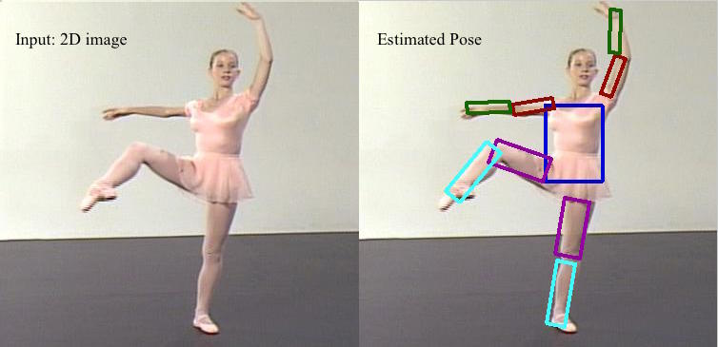
2. Human Pose Estimation
Estimate human poses/skeleton from 2D color videos
Using Max-covering method [1]
Figure 3: 2D human pose estimation
[1] http://www.cs.bc.edu/~hjiang/details/maxcovering/index.html

Slide 6
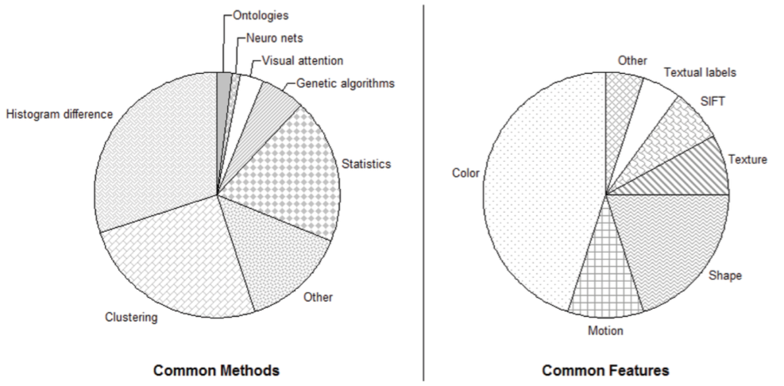
2. Key Frame Extraction
Extract key frames from 2D color/depth/skeleton videos
Histogram-based
Motion-based
Etc
Figure 4: Key frame extraction statistic [2]
[2] Mashtalir, Sergii, and Olena Mikhnova. "Key Frame Extraction from Video: Framework and Advances." International Journal of Computer Vision and Image Processing (IJCVIP) 4.2 (2014): 68-79.

Slide 7
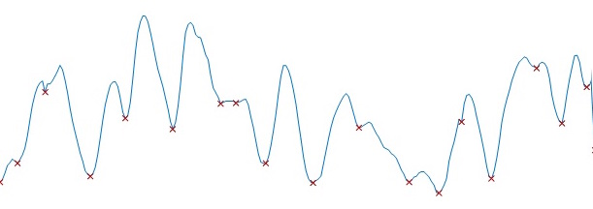
2. Key Frame Extraction
Motion-based idea: Key frames at local minimum motion frame.
Motion
Frame number or Time
Figure 5: Local minimum selection

Slide 8
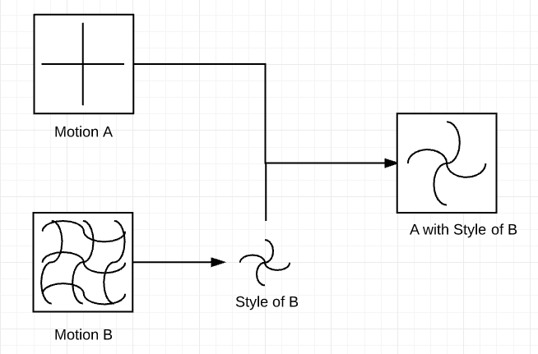
3. Human Style Transfer
Extract style from motions.
Apply extracted style to other motions to generate new motion.
Figure 6: Copy Style of motion B , apply to motion A

Slide 9
3 Existing techs
Massih et al, Siggraph 2016
Human ->Dragon. (unknown)
Xia et al, Siggraph 2015
Can process both labeled and unlabeled inputs.
Hsu et al, Siggraph 2005
Input motion must be labeled.
Yumer and Mitra, Siggraph 2016
Required less motion db compared to others.
Apply Deep Learning, siggraph 2016
No manual preprocessing (reading)

Slide 10
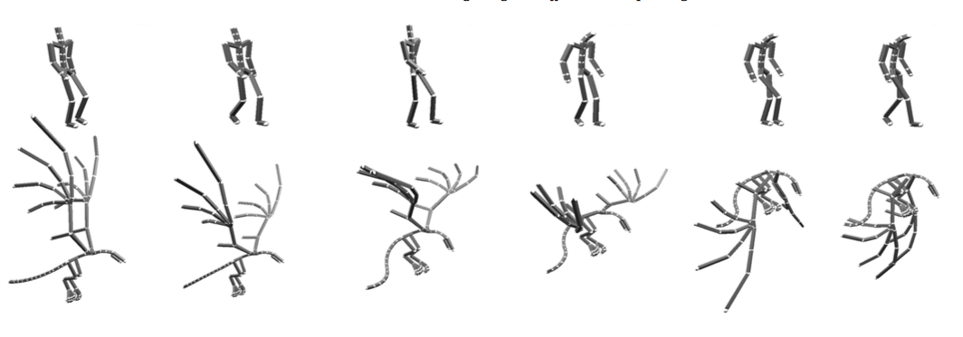
3.1 Massih et al, Siggraph 2016
Motion Style Retargeting to Characters with Different Morphologies, COMPUTER GRAPHICS forum, Volume 00 (2016).
Transferring style between different morphologies.
Figure 7: Transfer human motion style to a dragon
Demo https://www.youtube.com/watch?v=wQ9zXzPpf7c

Slide 11
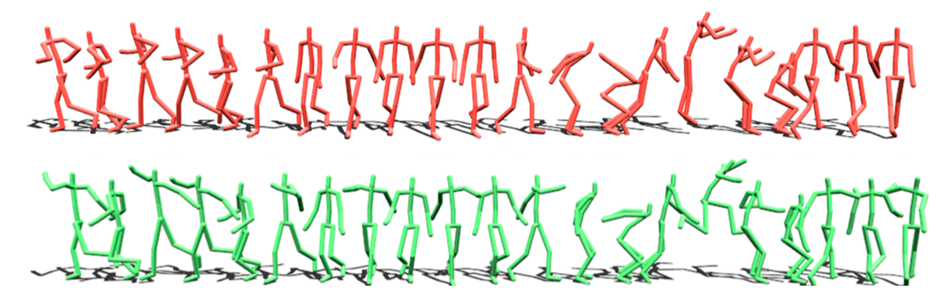
3.2 Xia et al, 2015
Real-time Style Transfer for Unlabeled Heterogeneous Human Motion, ACM Transactions on Graphics, 34(4): Article 119, 2015.
Figure 8: Our real-time style generation system automatically transforms an unlabeled, heterogeneous motion sequence into a new style. (top) the input motion in the “neutral” style; (bottom) the output animation in the “proud” style. Note the more energetic arm motions and jump in the stylized motion.
Demo: https://www.youtube.com/watch?v=6rRpKF0pTwI

Slide 12
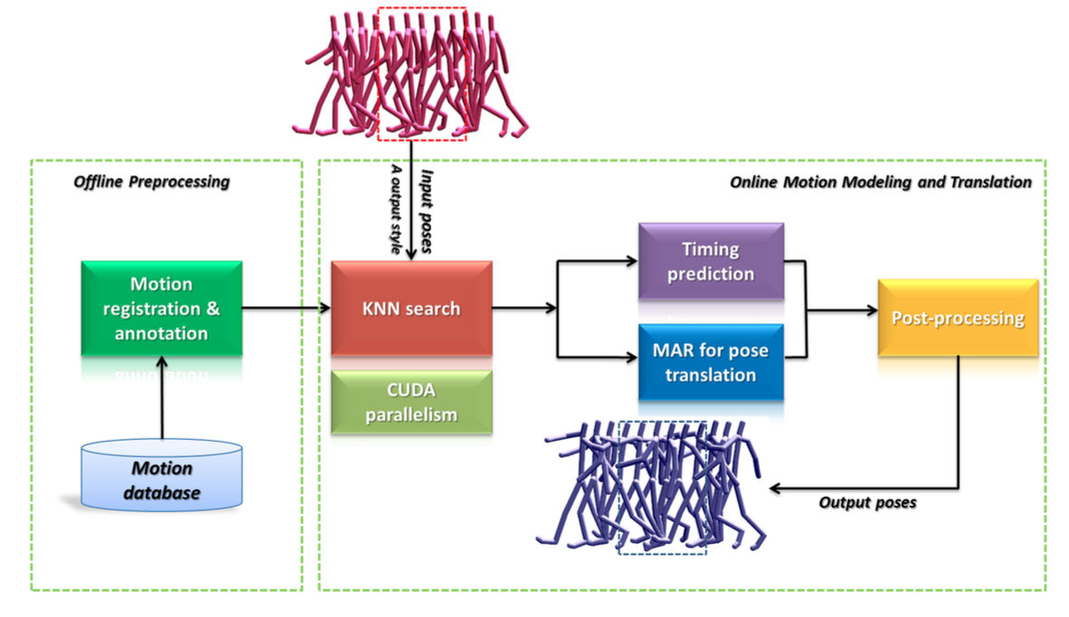
3.2 Xia et al, 2015
Figure 9: SIGRAPH 2015 System overview

Slide 13


3.2 Xia et al, 2015
Database (sequence) preprocessing: Motion registration and annotation
1 unit = (1action, 1 style)
Annotate motion style; Split sequence -> unit
Group all units by action, register frame-by-frame between unit in the same group.
KNN Search: Mapping and minimize
MAR for pose translation
Labeled input: using a regression model
Unlabeled input: using mixture regression model.
Timing prediction: The same idea with pose translation
Post processing: Eliminate footskate error.

Slide 14
3.3 Hsu et al, 2005
Almost the same with Xia et al, using LTI model

Slide 15
3.4 Yumer and Mitra, 2016
Use DFT to convert motion sequence to spectral domain.
Can transfer unseen action to new style.
Figure 10
Demo https://www.youtube.com/watch?v=MtlAIQnnm2Y

Slide 16
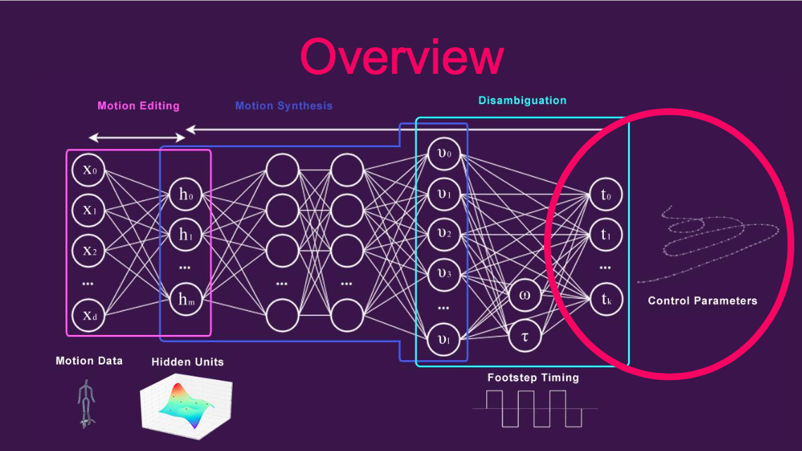
3.5 Holden et al, Deep Learning 2016.
Demo https://www.youtube.com/watch?v=urf-AAIwNYk

Slide 17
3.5 Holden et al, Deep Learning 2016.
Methods
CNN, Auto Encoder
Contributions
Explicitly separate Style and Content of motion
No manual preprocessing
Source + data available

Slide 18
3.6 Summary of style transfer techs
Massih et al, Siggraph 2016
Transfer motion style between different morphologies (Human ->Dragon).
Xia et al, Siggraph 2015
Transfer human motion style.
Using local MAR model, can process both labeled and unlabeled inputs.
Hsu et al, Siggraph 2005
Using LTI model, input motion must be labeled.
Yumer and Mitra, Siggraph 2016
Motion style transfer in spectral domain
Required less motion db in compared to others.
Holden et al, Deep Learning, siggraph 2016
No manual preprocessing
Explicitly extract style from motion

Slide 19
4. GAP of motion Registration and Annotation
Motion sequence = actions(walk, jump, etc) + styles(happy, sad, etc)
For instance: sequence1 = walk, then jump, then kick. Style happy.
Registration and Annotation
Split, align between sequences.
Labeled actions and style.
GAP of mentioned techniques
Record motion sequences themselves.
(Not sure) Almost manually align, label motions.
-> Difficult to reuse existing motion database, since inconsistency.
-> Why don’t we align, labeled (action, style) automatically

Slide 20
4. Motion Registration and Annotation
SEGMENTATION AND CLASSIFICATION OF HUMAN ACTIONS AND ACTOR CHARACTERISTICS WITH 3D MOTION DATA (International Journal of Artificial Intelligence & Applications (IJAIA), Vol.3, No.4, July 2012)
Classify 3D human action using three methods
Nearest neighbor search
Hidden Markov models
Artificial neural network

Slide 21
My research plan
Config and run
Xia et al 2015, using local MAR
Holden et al 2016, using Deep learning
Implement
Yumer et al 2016, Transfer in spectral domain

Slide 22
Thanks for listening
Q&A

